Slide 1

Spam mail Detection using Machine Learning

Slide 2
Presented By:
Name ID
T.Mourya sai nath reddy 2411021060194
K.V.Sasidhar goud 2411021060169
A.Varun Reddy 2411021060190
R.Jaswanth Gowd 2411021060081
presented to:-
Dr R C Karpagalakshmi Professor / CSE
on
08/04/2026

Slide 3
Literature Review:-
Spam detection has been widely studied using Machine Learning techniques
Common algorithms:
Naive Bayes
Support Vector Machine (SVM)
Decision Trees
Previous research shows:
Naive Bayes performs well for text classification
High accuracy achieved using Bag of Words approach
Limitations in existing systems:
Difficulty handling new spam patterns
Context understanding is limited

Slide 4
Problem Definition
University students receive a large number of messages daily
Many messages are spam, such as Fake internship offers, Fraudulent scholarship messages. These spam messages can lead to Financial loss, Data theft and privacy issues
Manual filtering is Time-consuming, Inefficient and Error-prone
Therefore, there is a need for an automated spam detection system designed for students to improve security and efficiency

Slide 5
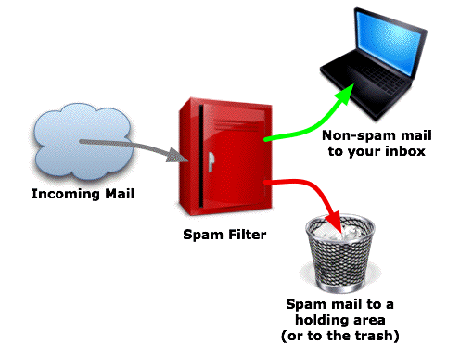
Working of Spam Filter System
mail
Incoming mail
Spam mail

Slide 6
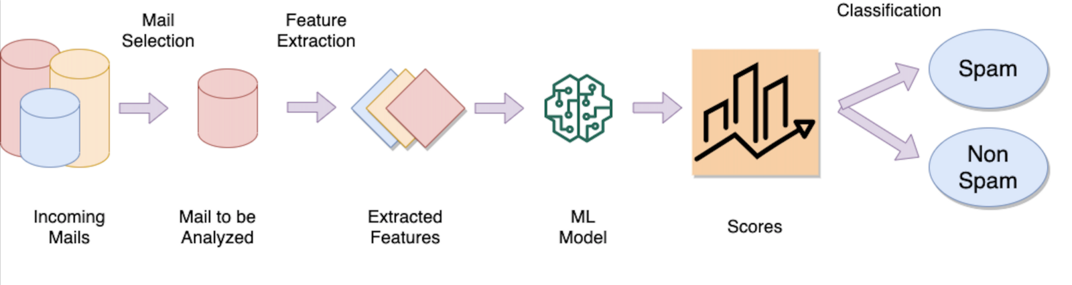
Methodology
1.DATA COLLECTON
2.Data Preprocessing
3.Feature Extraction
4. Model Training
5. Testing

Slide 7
Naïve Bayes Algorithm
Naïve Bayesian method is used for the learning process. Analyze a mail to calculate its probability of being a Spam using individual characteristic of words in the mail.
For each word in the mail, Calculate the following:
S(w)=(number of Spam emails containing the word)/(total number of Spam emails)
H(w)=(number of Ham emails containing the word)/(total number of Ham emails)
P(w)=S(w)/(S(w)+H(w))
P(w) can be interpreted as the probability that a randomly chosen email containing the word w is Spam.

Slide 8
✅ Modules
1. Data Collection Module
Collect SMS dataset
Contains spam and ham messages
2. Data Preprocessing Module
Clean the text data
Convert to lowercase
Remove punctuation and special characters
3. Feature Extraction Module
Convert text into numerical format
Use Bag of Words / CountVectorizer
4. Model Training Module
Train the model using dataset
Use Naive Bayes algorithm
5. Prediction (Classification) Module
Take new message as input
Predict whether it is Spam or Ham

Slide 9
Performance Measure
Accuracy = $\frac{\text{True} \text{Positive}\text{ + }\text{True} \text{Negetive} }{\text{Total} \text{Number} \text{of} \text{Test} \text{Data}}$
Spams caught (SC) = $\frac{\text{False} \text{negative} \text{cases}}{\text{Number} \text{of} \text{Spams} }$
Blocked hams (BH) = $\frac{\text{False} \text{Positive} \text{cases}}{\text{Number} \text{of} \text{Hams}}$

Slide 10
System Architecture
SMS Text
Pre - Processing
Features Extraction
Algorithm
Training
Classification of new Text
New SMS Text
Pre - Processing
Features Extraction
Classifier Model
Tasting

Slide 11
Results and Discussions
Accuracy achieved: ~97–99%
Model performs well on test data
Advantages:
Fast processing
High efficiency
Observations:
Works best with clean dataset
Struggles with modified spam words
Overall Error % | 1.12
Accuracy % | 98.88
SC % | 94.5
BH % | 0.51

Slide 12
Conclusion:
Successfully built spam detection system
High accuracy achieved
Helps improve user security
Future Enhancements:
Improve detection of modified spam words
Add multi-category classification
Real-time deployment

Slide 13
References:
https://en.wikipedia.org/wiki/Naive_Bayes_spam_filtering
https://en.wikipedia.org/wiki/Naive_Bayes_classifier
https://stackoverflow.com/questions/10059594/a-simple-explanation-of-naive-bayes-classification
https://link.springer.com/chapter/10.1007/3-540-31662-0_38?no-access=true
https://www.youtube.com/watch?v=EGKeC2S44Rs

Slide 14
Thanks!
Any questions?

